Slide 1
Introduction to Linux Systems Download Lite Windows Carla
Chia-Heng Tu
Dept. of Computer Science and Information Engineering
National Cheng Kung University
Fall 2024

Slide 2
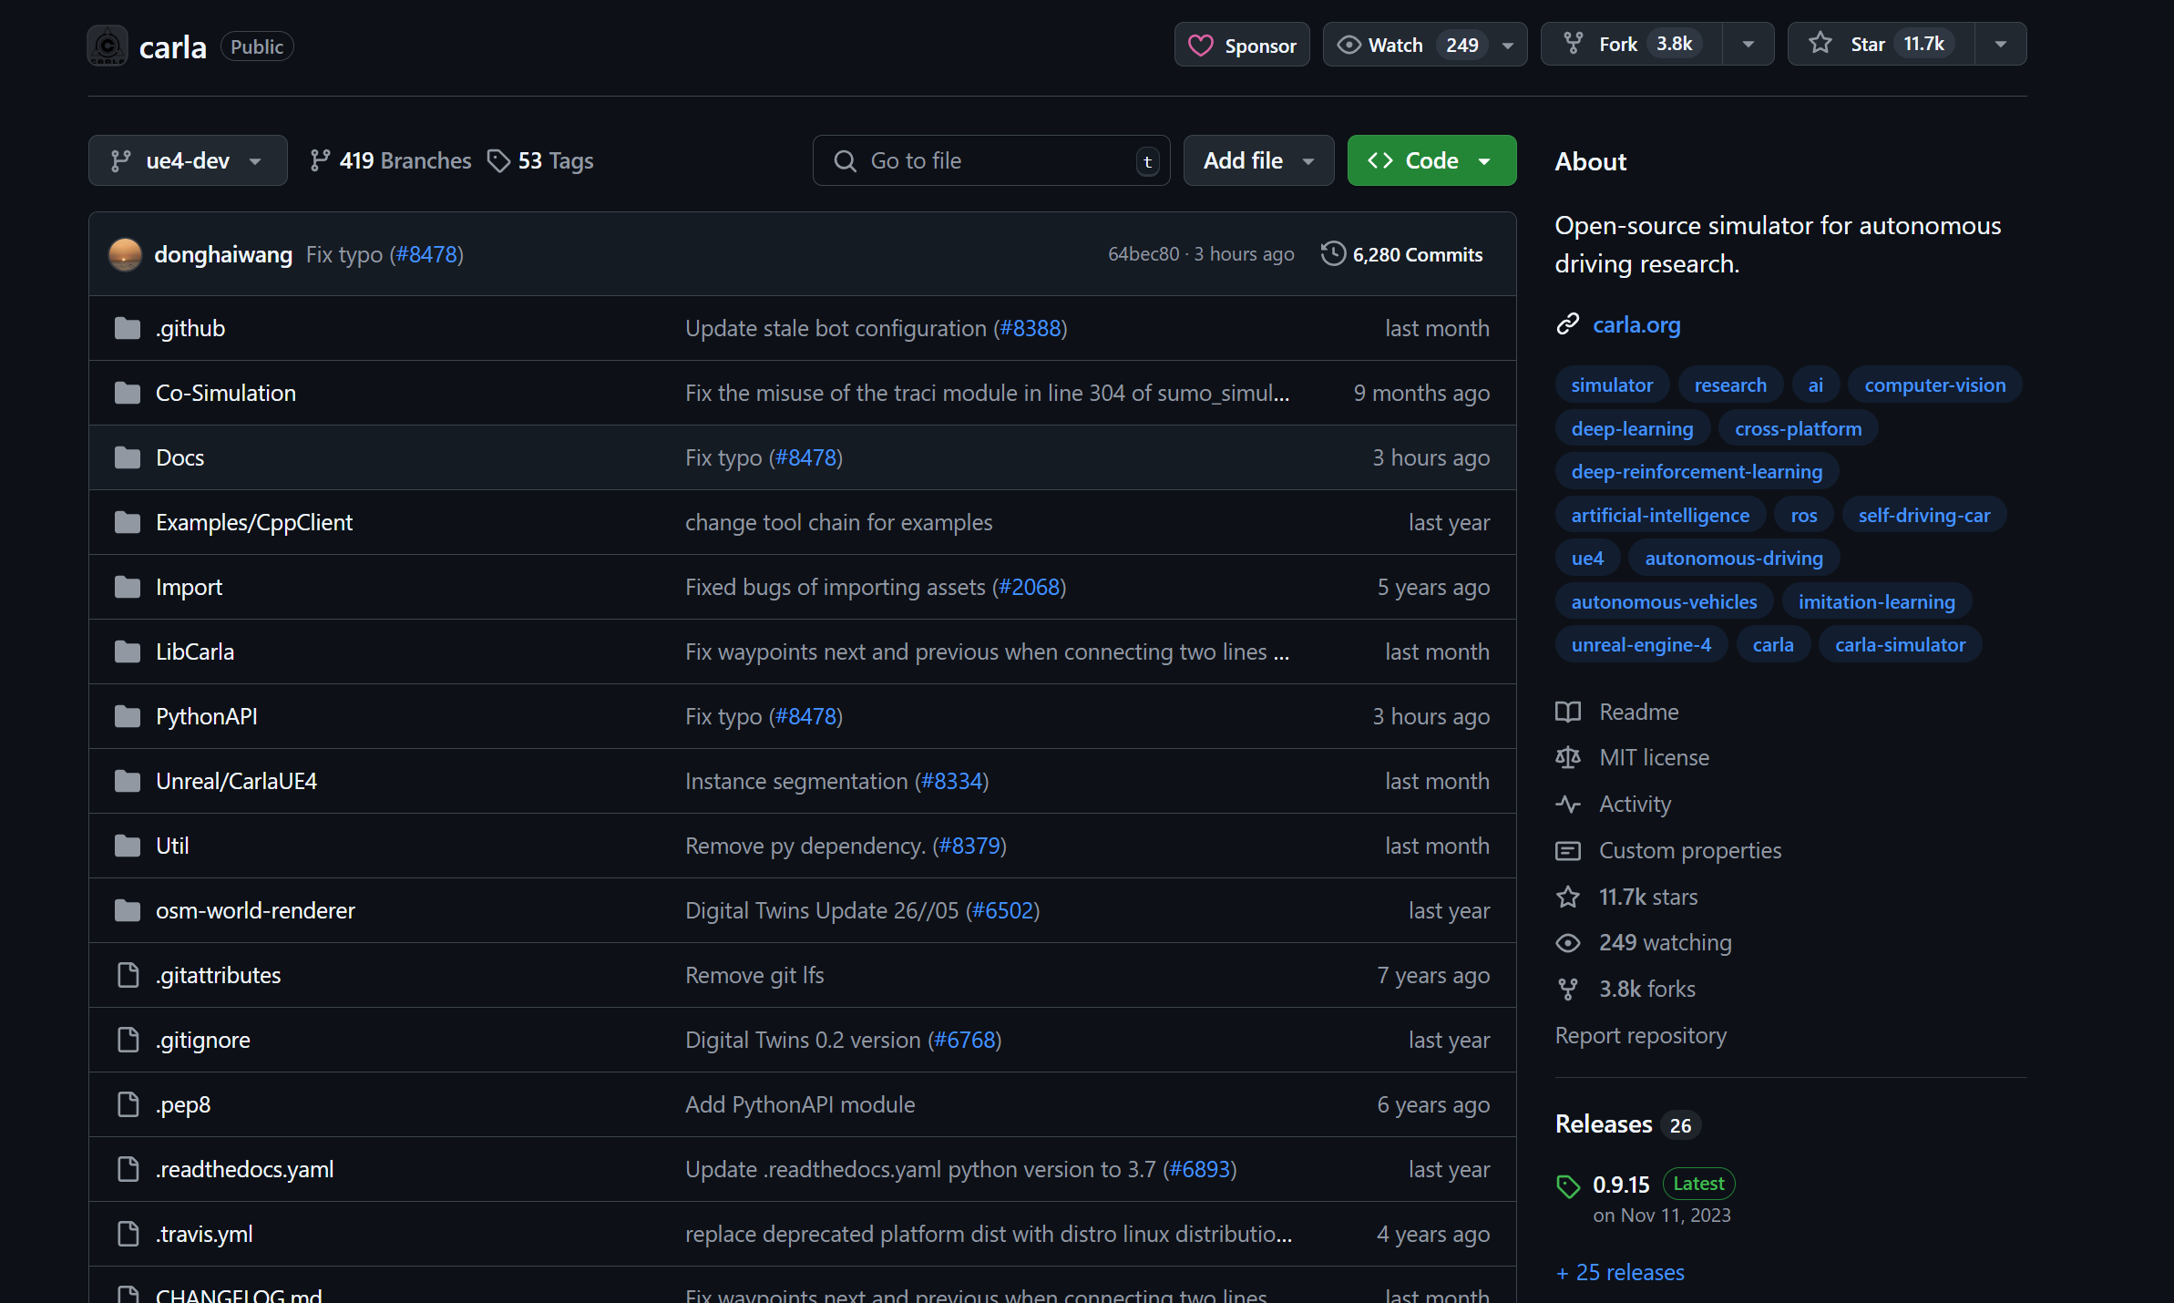
Carla Github
https://github.com/carla-simulator/carla
Click here

Slide 3
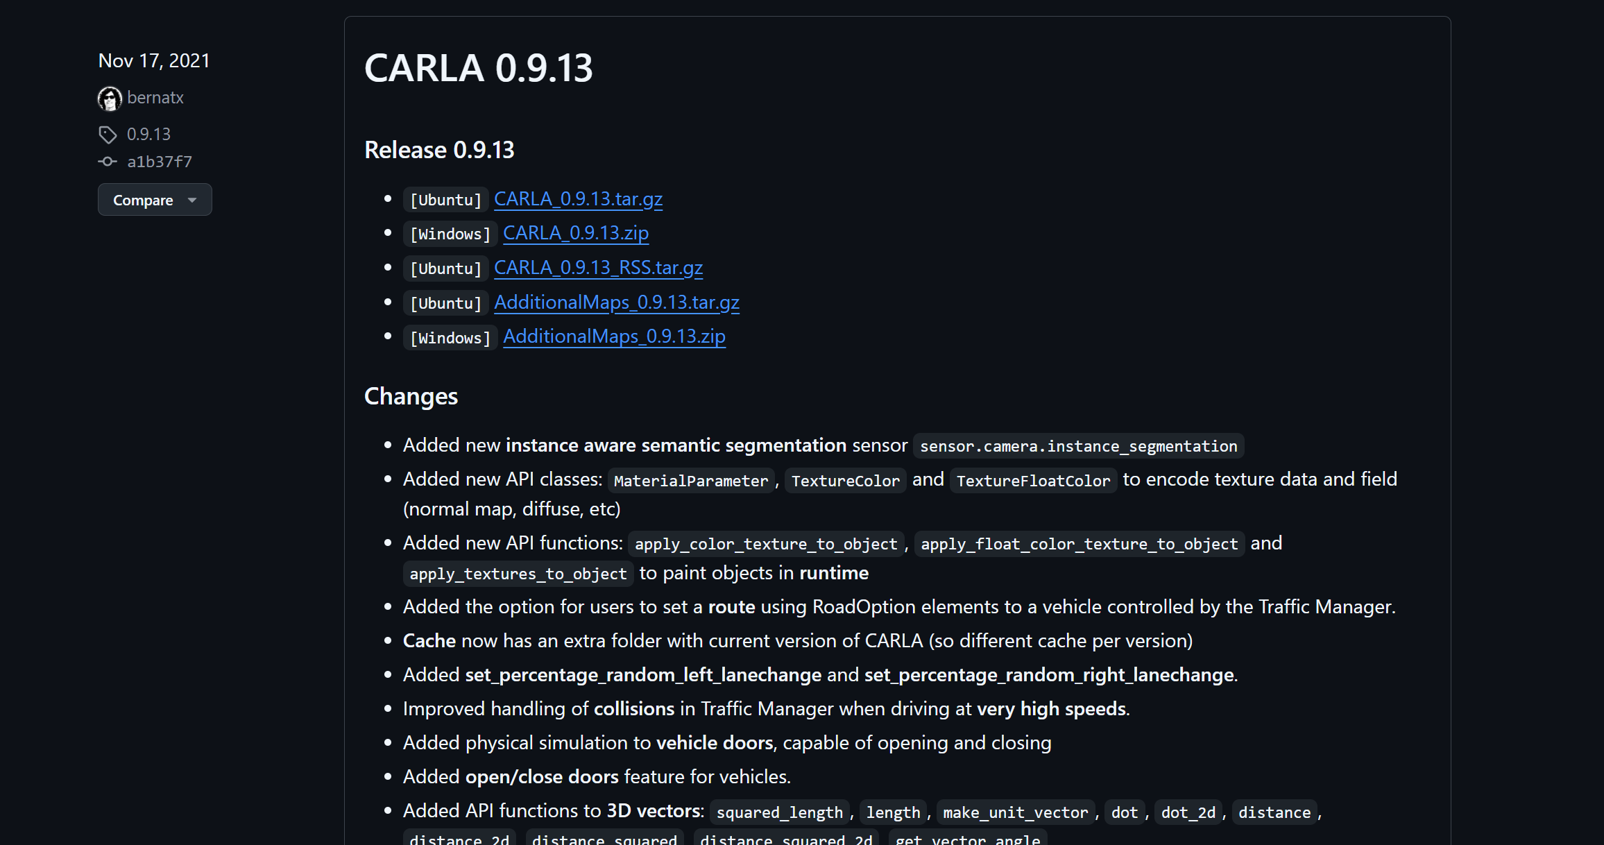
Download Carla

Slide 4
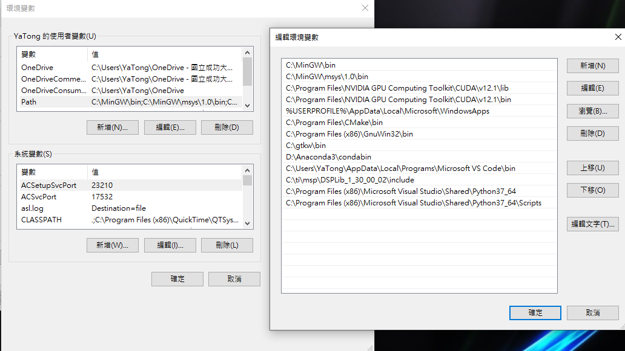
Setting Environment Variables
Install python 3.7.9 and set environment variables
請根據安裝時的路徑找到Python37所在的位置

Slide 5
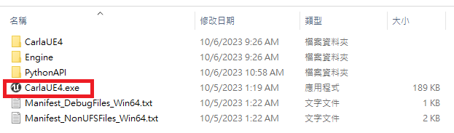
Open Lite Windows Carla
Run CarlaUE4.exe

Slide 6
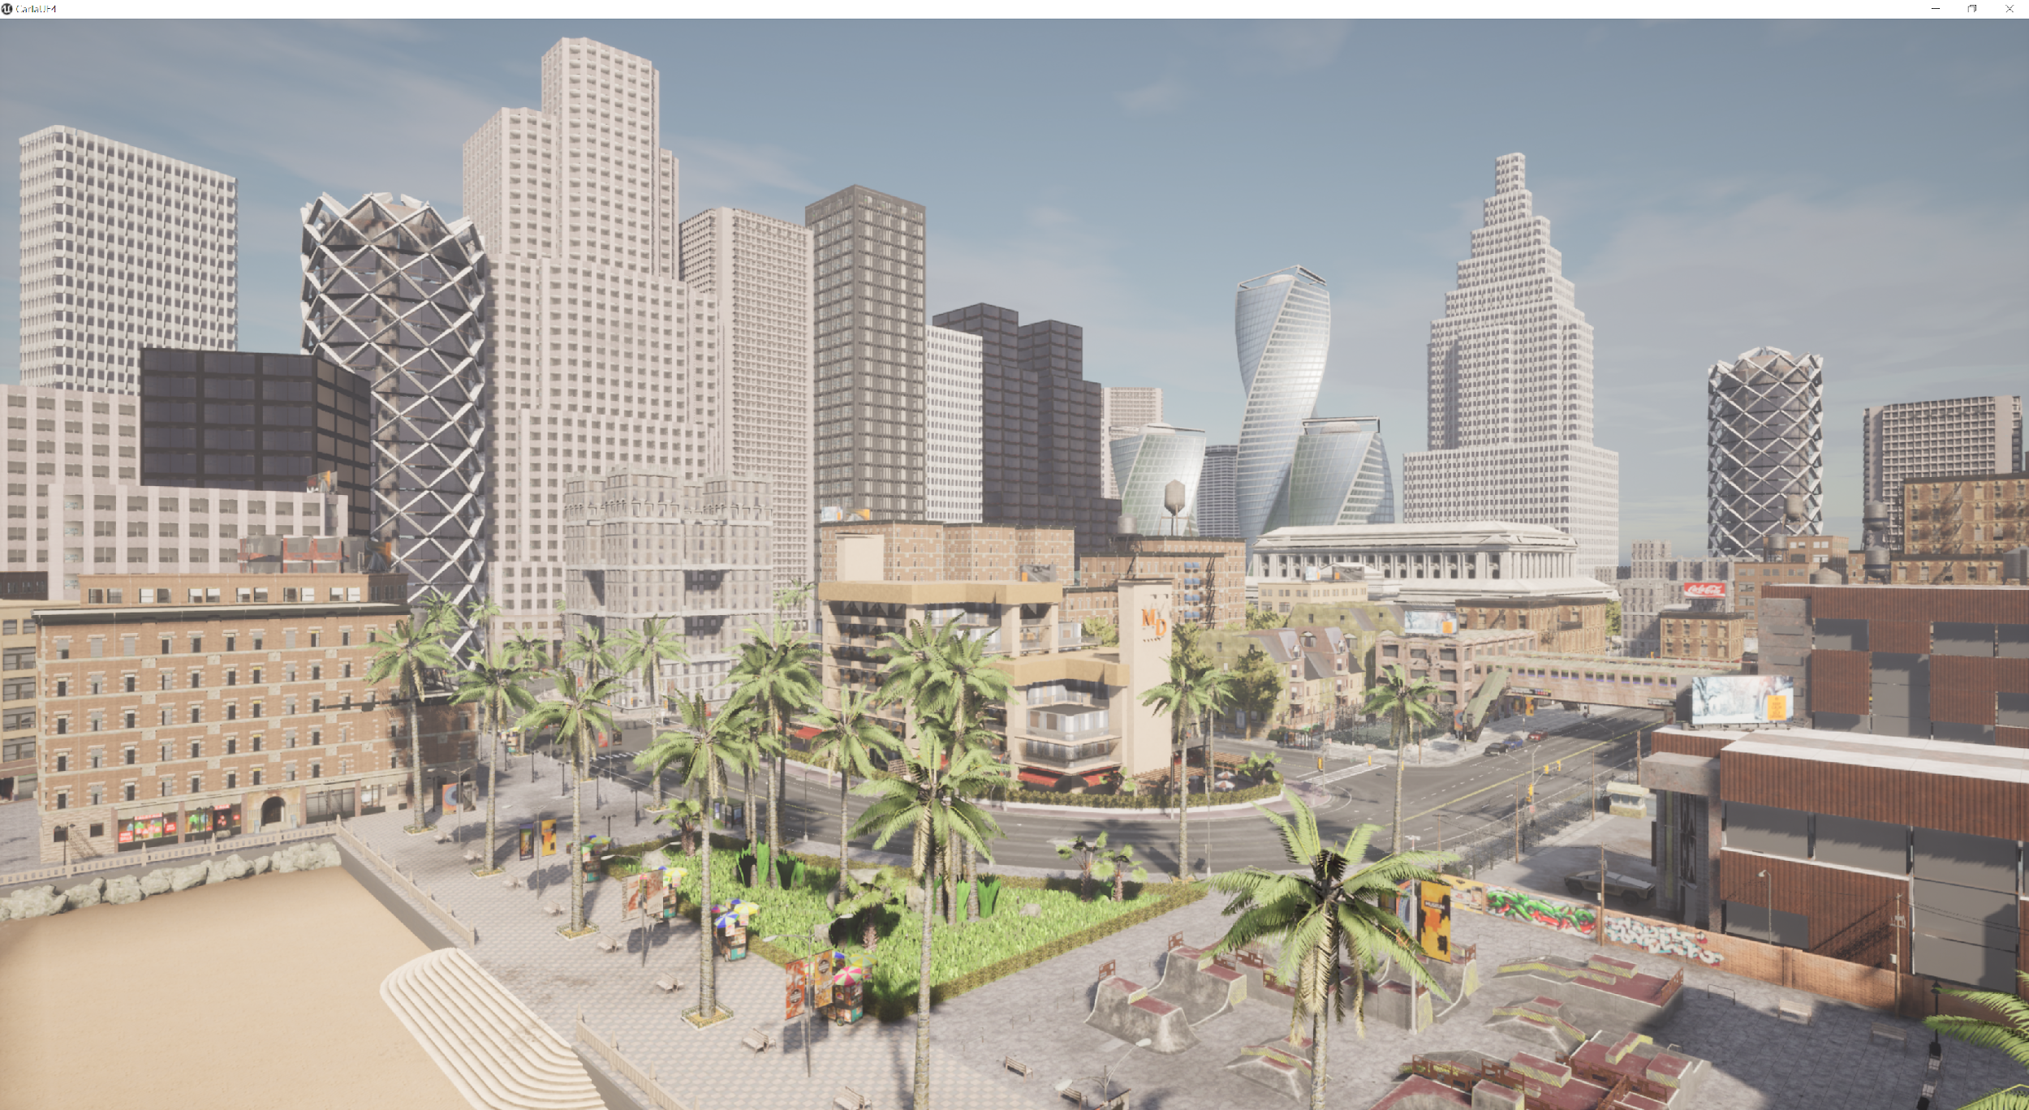
Lite Windows Carla

Slide 7
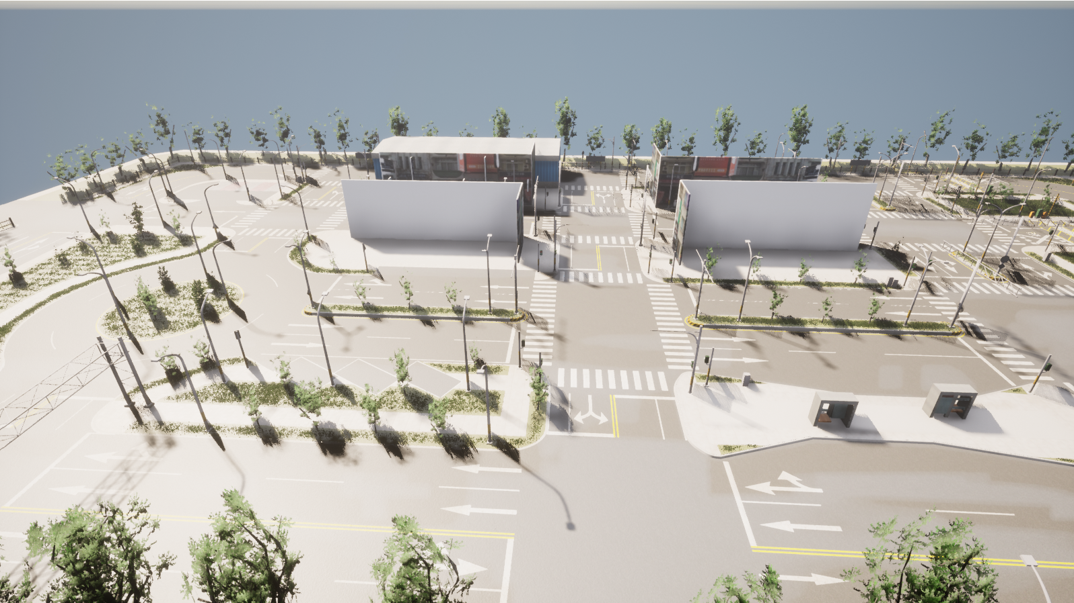
Lite Windows Carla (Cont’d)
Use W, A, S, D, and mouse to adjust the view

Slide 8
Test Python Script
$ cd WindowsNoEditor/PythonAPI/examples
$ pip3 install -r requirements.txt
$ python generate_traffic.py
Notes:
https://carla.readthedocs.io/en/0.9.13/build_windows/

Slide 9
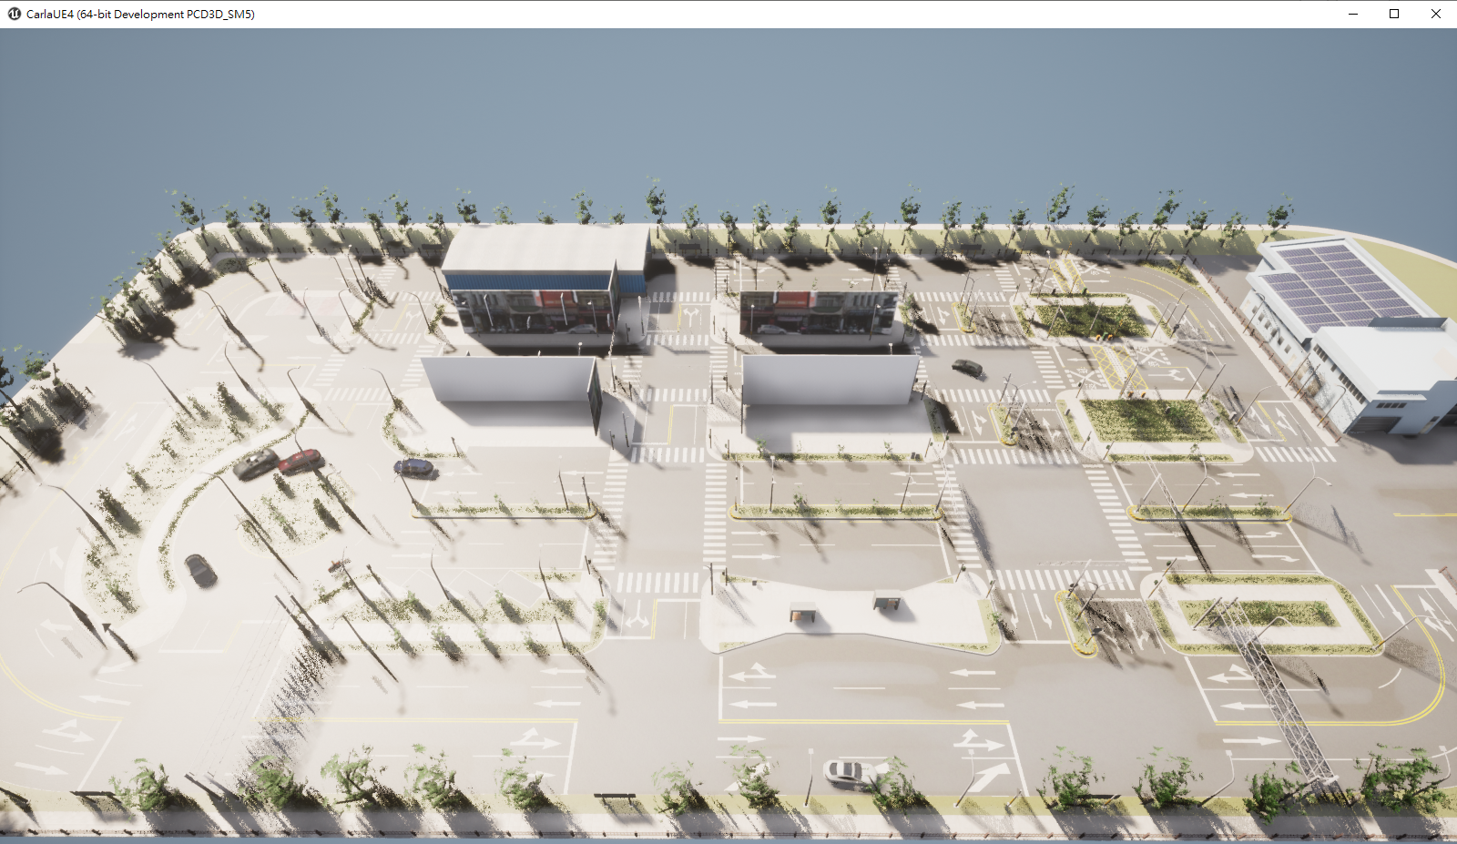
Result

Slide 10
QUESTIONS

